Slide 1


RESULTS of the
Future schools using the power of Virtual and Augmented Reality for education and training in the classroom
Ref.no.2018-1-RO01-KA201-049411
C2 - Short-term joint staff Training Event on
How to implement VR laboratories in your school
28.06 – 02.07.2021, online

Slide 2
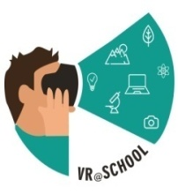

The Funding Programme/Project
Programme: Erasmus+
Key Action: Cooperation for innovation and the exchange of good practices
Action: Strategic Partnerships
Field: Strategic Partnerships for school education
Project Title: Future schools using the power of Virtual and Augmented Reality for education and training in the classroom
Project Acronym: VR@School
Ref. no.: 2018-1-RO01-KA201-049411
Project Start Date: 01.09.2018
Project End date: 31.08.2021

Slide 3
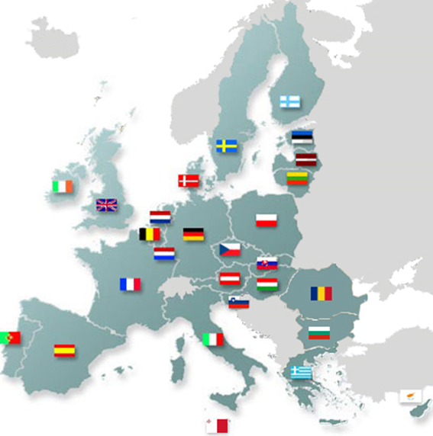
Partership
P8: Vilniaus Karoliniskiu Gymnasium, Vilnius (Lithuania) - www.vkg.vilnius.lm.lt
P1: Liceul Teoretic de Informatica "Grigore Moisil", Iasi (Romania) - www.liis.ro
P7: Soros International House, Vilnius (Lithuania) - www.sih.lt
P2: Fundatia EuroEd, Iasi (Romania) – www.euroed.ro
P6: Instituto Politécnico de Bragança, Braganca (Portugal) - www.ipb.pt
P3: Make up your business, Iasi (Romania) - www.makeupyourbusiness.com
P4: Pixel Associazione, Florence (Italy) - www.pixel-online.net
P5: CIPAT, Florence (Italy) - www.cipat.it

Slide 4

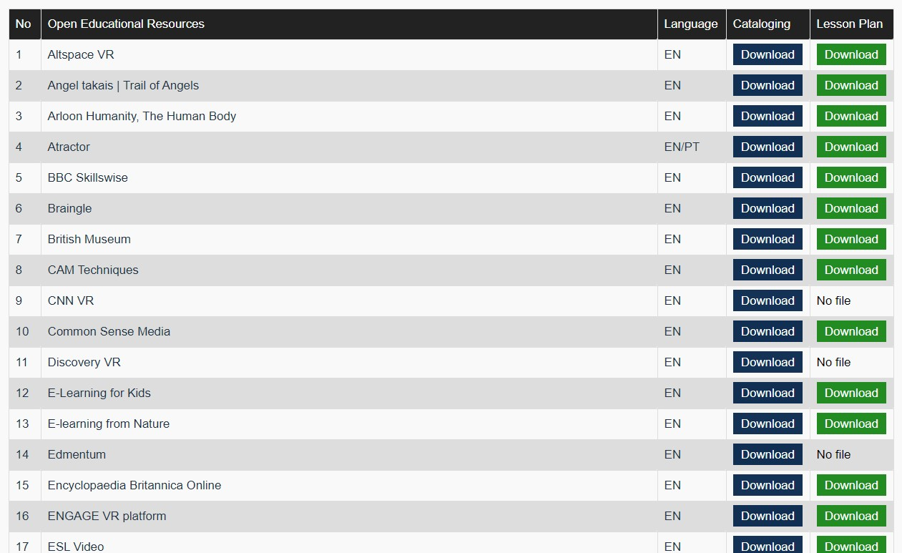
R1: Teach@School Online Library
50 Open Educational Resources – with description & lesson plans
https://vr-school.eu/lectii

Slide 5
R1: Teach@School Online Library
The cataloguing the OER includes:
Title
Author
Date of production
Website of the resource
Type of online learning resource
Type of media
Language
Audience
Students Age
Subject/Topic
Purpose
Use
Description of Contents
Description of how the resource can be used with students
Reviewer’s comments on the Resource
Name of the reviewing organisation
The lesson plan includes:
Teachers skills
Age group/class
Lesson title
Key concepts
Aims
Objectives
Skills developed
Materials needed
Online resources
Assumptions (some students may have problems with…)
Procedures: Introduction, Engaging, Explaining/Activating, Follow up, Formative Assessment

Slide 6
R2: Teachers Guide on Virtual Reality in school education
6 Learning Modules, available in 5 languages (EN, RO, IT, LT, PT)
6 Video Tutorials (with short intro of each module)
https://vr-school.eu/io2

Slide 7
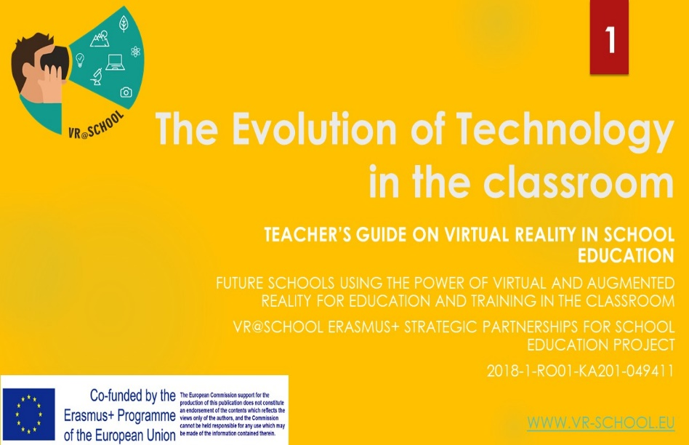
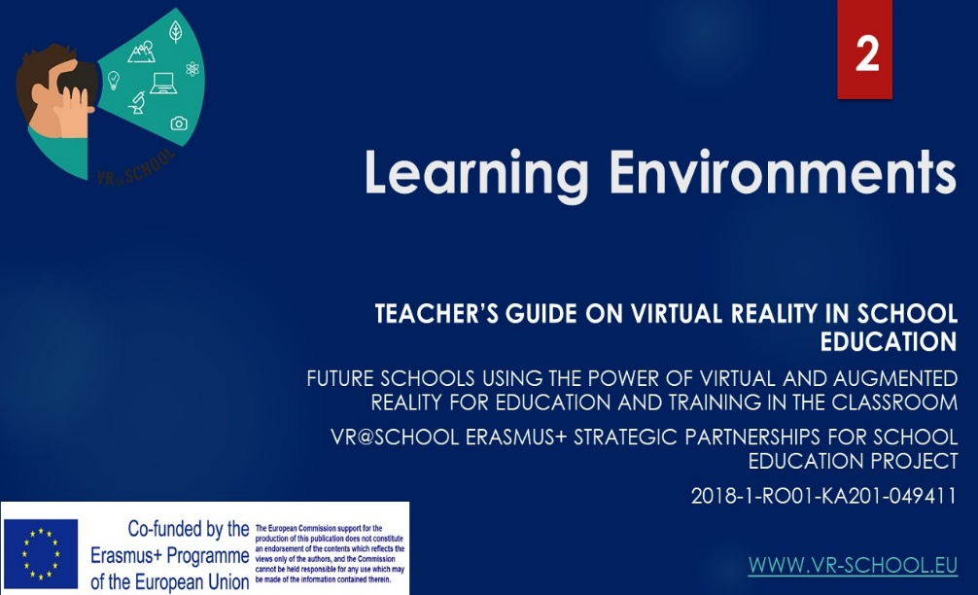
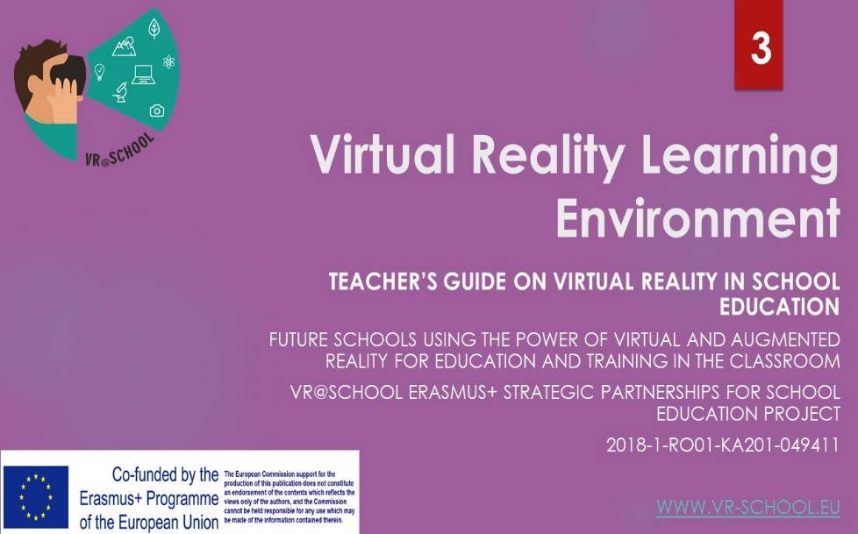
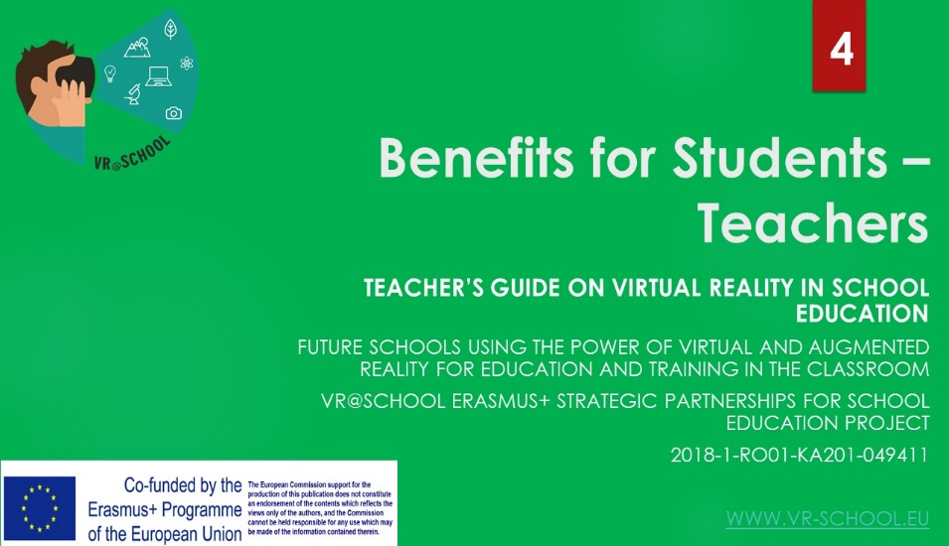
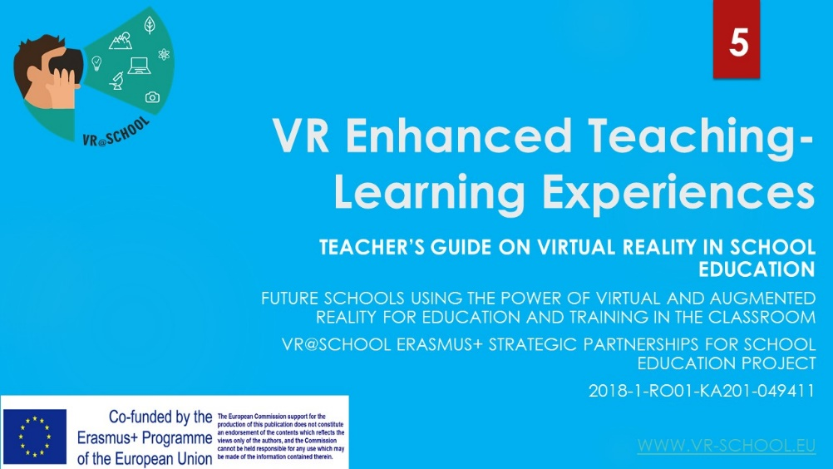
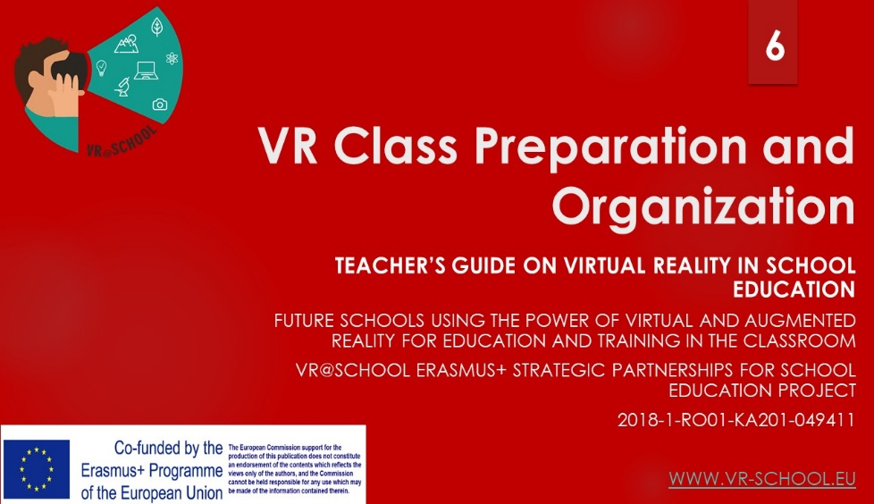
R2: Teachers Guide on Virtual Reality in school education
https://vr-school.eu/io2

Slide 8
R3: Trainings for teachers
2 international trainings (1 face-to-face in Romania, and 1 online)
5 national trainings(done in IT, LT, PT and 2 in RO)
Over 130 teachers and trainers have been trained on the use of the VR@School Guide on Virtual Reality in school education
https://vr-school.eu/io2

Slide 9
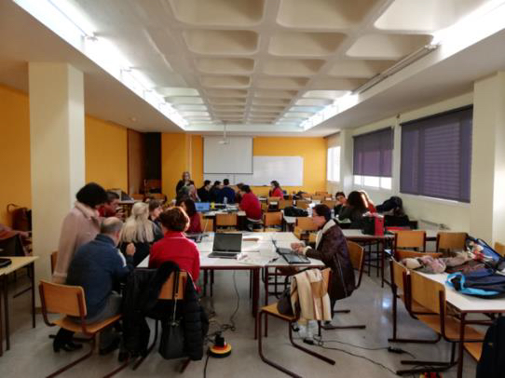
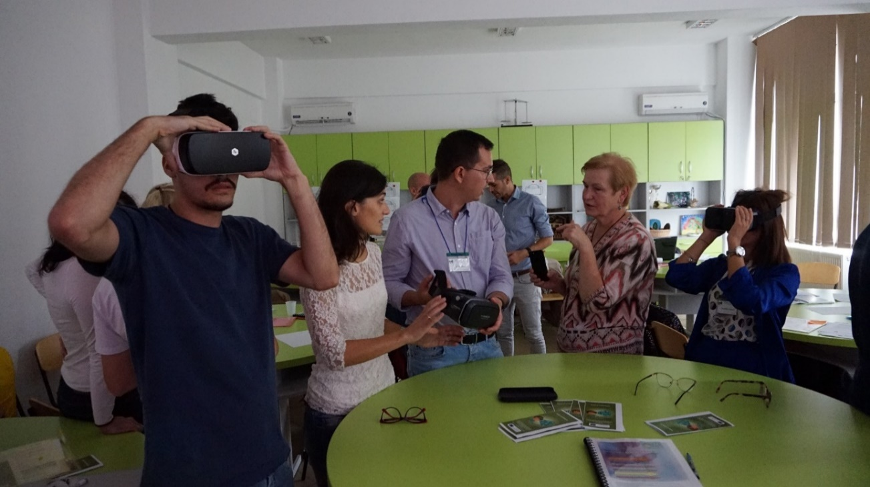
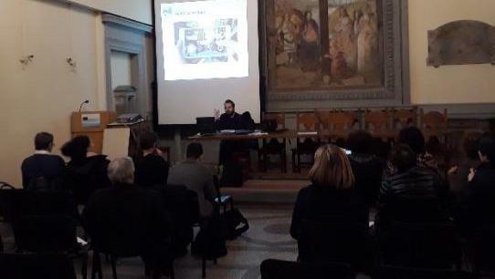
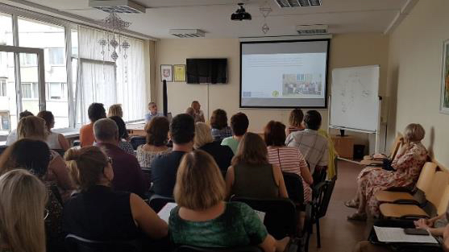
R3: Trainings for teachers

Slide 10
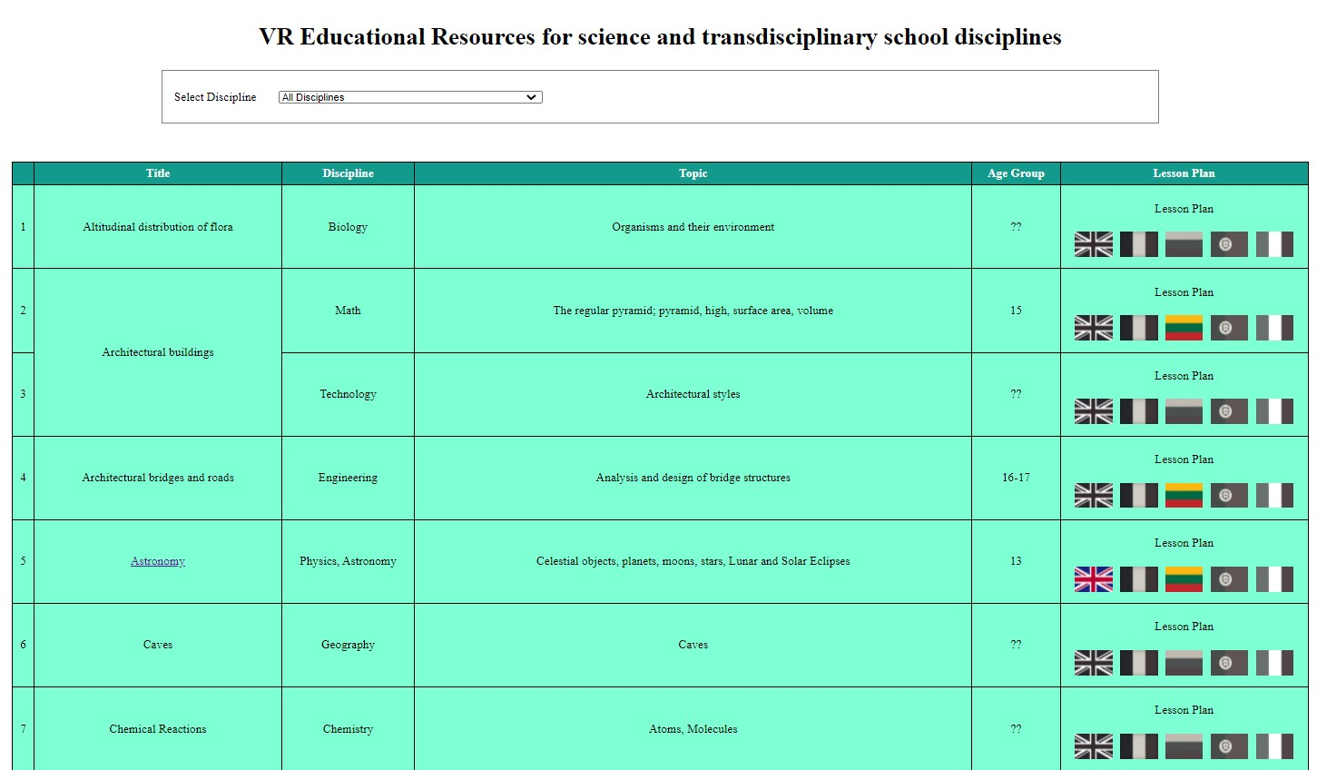
R4: VR Educational Resources
40+ VR materials and lesson plans available in 5 languages
https://eloquent-ramanujan-887aa5.netlify.app/

Slide 11
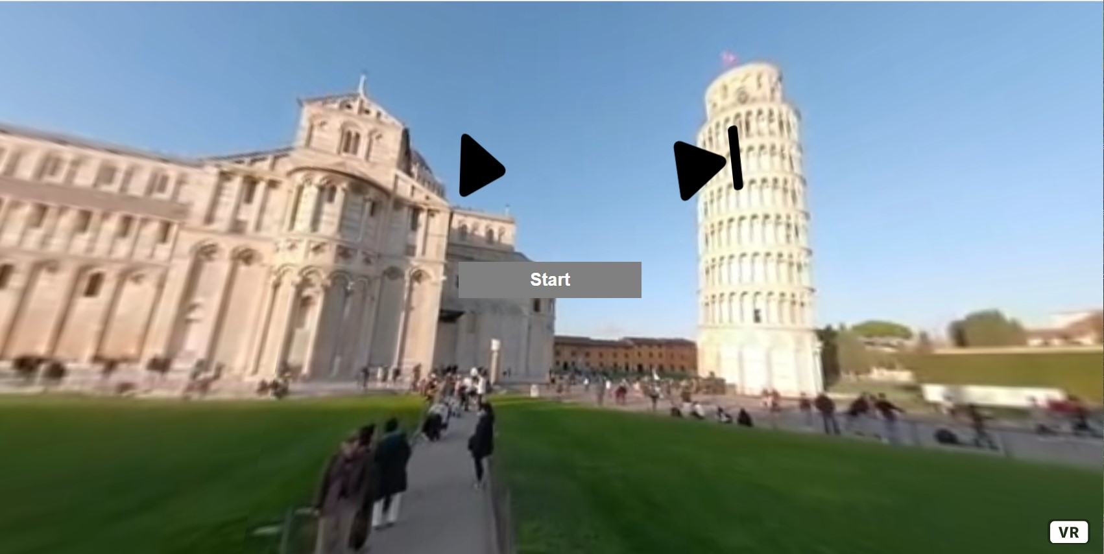
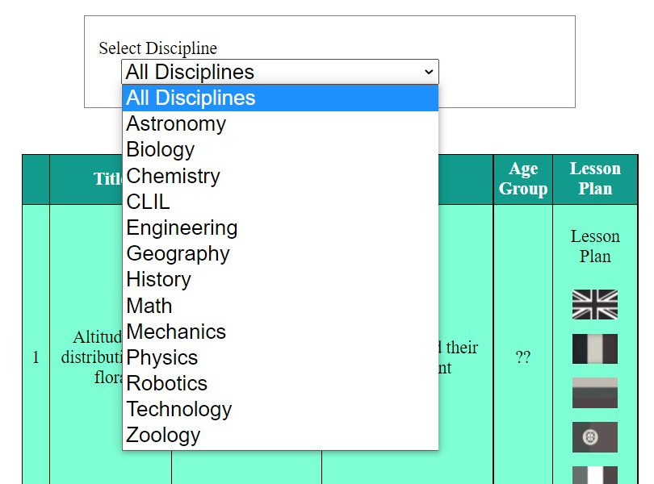
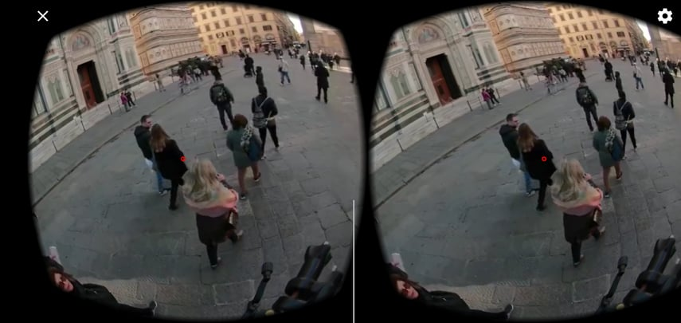
R4: VR Educational Resources
13 school disciplines, with various topics

Slide 12
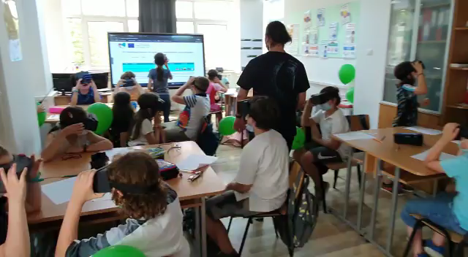
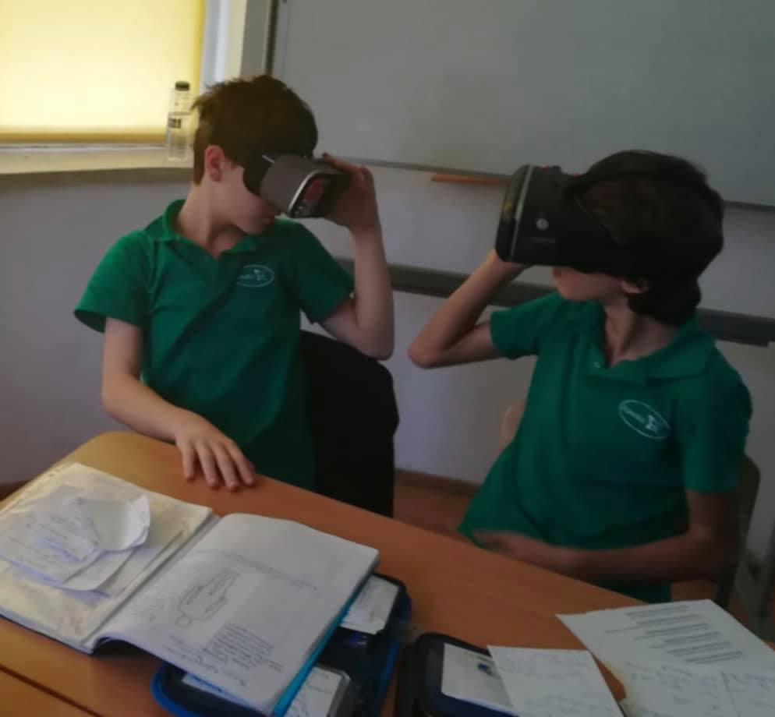
R5: VR School Laboratories
5 VR School Laboratories
Simulation Lessons using VR@School resources with students and teachers

Slide 13
Website https://vr-school.eu
Facebook @VRatSchool
Contact: adina_romanescu@yahoo.com andreea.cleminte@euroed.ro
C2 - Short-term joint staff Training Event on
How to implement VR laboratories in your school
28.06 – 02.07.2021, online

